Slide 1


CCNP SWITCH v7.1
Chapter 8: Switching Features and Technologies for the Campus Network

Slide 2
Focus on topics
Discovery protocols
Power over Ethernet
SDM templates
Monitoring features
IP SLA
2

Slide 3

Discovery Protocols
Notes:
High availability is not just about adding redundant devices. It implies planning to understand where the points of failure occur and designing the network so that an alternative solution exists to compensate for the loss of these points of failure.
This chapters provides an overview on how to implement a high-availability solution according to a given network design and requirements. This includes building a resilient network with optimal redundancy for high availability. Monitoring the network using SNMP, Syslog, and IP SLA are key elements to ensure the high availability of the network.
This chapter also covers supervisor redundancy options such as RPR, RPR+, SSO, and NSF.
For ensuring first hop gateway redundancy, the Hot Standby Router Protocol (HSRP), Virtual Router Redundancy Protocol (VRRP) and Gateway Load Balancing Protocol (GLBP) are needed. First hop redundancy protocols (FHRP) allow for nondisruptive failover between available redundant gateways. HSRP/VRRP allow for one primary router per subnet with other routers acting as standby/backup. GLBP allows load balancing across multiple gateways for the same subnet.
High availability is technology that enables networkwide resilience to increase IP network availability. Network applications must cross different network segments—from the Enterprise Backbone, Enterprise Edge, and Service Provider Edge, through the Service Provider Core. All segments must be resilient to recover quickly enough for faults to be transparent to users and network applications. This chapter describes the high availability concept, how resiliency is built, and how the network is designed to always offer a path between any pair of end points.

Slide 4
Cisco Discovery Protocol (CDP)
Cisco Discovery Protocol (CDP) was the original link layer protocol for the exchange of information
For many years, network operations and troubleshooters used CDP as the first-step in building topology, troubleshooting, and so on
Many network tools leveraged CDP for neighbor information and mapping.
However, being a Cisco proprietary protocol, it could not be used interoperability, so the IEEE Link Layer Discovery Protocol (LLDP) was formulated.

Slide 5
Introduction to LLDP
All current Cisco devices support LLDP.
The table below recaps the differences between CDP and LLDP
An advantage of LLDP over CDP is that is allows for customization. LLDP can carry a lot of information that is relevant to your network
As a result, LLDP is not that lightweight.
 | CDP | LLDP
Standard | No, Cisco proprietary | Defined as IEEE 802.1AB
Runs at | Layer 2: Data link layer | Layer 2: Data link layer
Benefits | Lightweight, may contain Cisco-specific information | Highly customizable

Slide 6
Properties of LLDP
The following list captures a few important implementation properties of LLDP:
LLDP is unidirectional
LLDP operates only in an advertising mode
LLDP does not solicit for information or monitor state changes between LLDP modes
LLDP leverages a Layer 2 multicast frame to notify neighbors of itself and its properties
LLDP will receive and record all information it receives about its neighbors
LLDP uses 01:80:c2:00:00:0e, 01:80:c2:00:00:03, or 01:80:c2:00:00:00 as the destination multicast address. Note that the 01 as the first octet signifies a Layer 2 multicast address.

Slide 7
Introduction to LLDP
The following list defines the most common information exchanged with LLDP with campus switches:
System name and description
Port name and description
Port VLAN and VLAN name
Management IP address
System Capabilities (WiFi, routing, switching, and so on)
Power over Ethernet
Link aggregation

Slide 8
Basic Configuration of LLDP
CDP is enabled by default on all Cisco devices, but LLDP may be either enabled or disabled by default, depending on hardware platform and software version.
The command lldp run enables LLDP globally.
To disable it, use no lldp run
The command lldp enable enables LLDP on an interface.
In some cases you may want to disable LLDP on a particular interface, for example, to an interface connected to the Internet.
To disable LLDP on a specific interface, you need to disable both LLDP from receiving or transmitting LLDP by using both the no lldp receive and no lldp transmit commands.

Slide 9
LLDP Configuration Example
This example shows how to enable LLDP on a device; disable LLDP on some interfaces; configure optional parameters such as hold time, delay time, and update frequency; and disable several LLDP TLVs:
switch# config t
Enter configuration commands, one per line. End with CNTL/Z.
switch(config)# lldp run
switch(config)# interface ethernet 7/9
switch(config-if)# no lldp transmit
switch(config-if)# no lldp receive
switch(config-if)# exit
switch(config)# interface ethernet 7/10
switch(config-if)# no lldp transmit
switch(config-if)# no lldp receive
switch(config-if)# exit
switch(config)# lldp holdtime 200
switch(config)# lldp reinit 5
switch(config)# lldp timer 50
switch(config)# no lldp tlv-select port-vlan
switch(config)# no lldp tlv-select system-name

Slide 10
Displaying LLDP Information
When LLDP is enabled the command show lldp neighbor displays a summary of which devices are seen on which ports.
switch(config)# lldp run
switch(config)# end
switch# show lldp neighbor
Capability codes:
(R) Router, (B) Bridge, (T) Telephone, (C) DOCSIS Cable Device
(W) WLAN Access Point, (P) Repeater, (S) Station, (O) Other
Device ID Local Intf Hold-time Capability Port ID
c2960-8 Fa0/8 120 B Fa0/8
Total entries displayed: 1
Notes:
Just like CDP, when LLDP is enabled the command show lldp neighbor displays a summary of which devices are seen on which ports.
You can get more detailed information about all neighbors with the command show lldp neighbor detail. If you need detailed information about only one neighbor on one link, you can also use, for example, show lldp neighbor interface f0/8 detail.

Slide 11
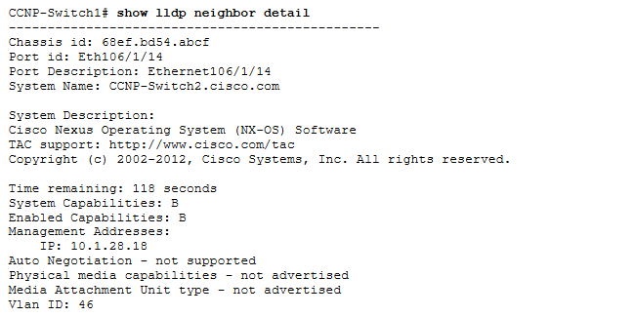
Displaying LLDP Information

Slide 12
LLDP Traffic Information
The show llldp traffic command shows you the statistics on exchanged LLDP frames between a device and its neighbors.

Slide 13

Power over Ethernet (PoE)
Notes:
Network security vulnerabilities include loss of privacy, data theft, impersonation, and loss of integrity. Basic security measures should be taken on every network to mitigate adverse effects of user negligence or acts of malicious intent. Best practices following these general steps are required whenever placing new equipment in service.
Step 1. Consider or establish organizational security policies.
Step 2. Secure switch device and protocols.
Step 3. Mitigate compromises launched through a switch.

Slide 14
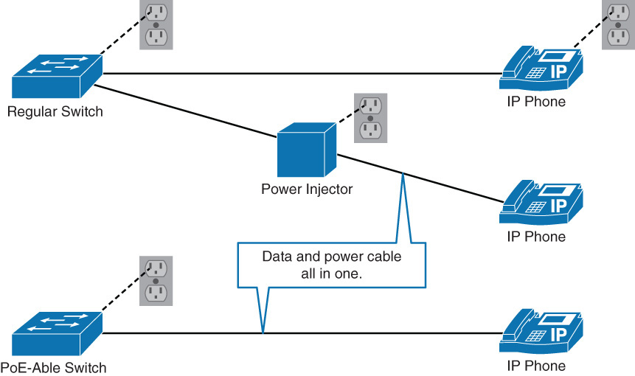
Power over Ethernet
Power over Ethernet (PoE), also referred to as in-line power, supplies power to devices through the same cable as data.
Cisco Catalyst switches support PoE on specific models of switches.
In the Campus network, PoE most commonly uses Cisco Catalyst switches to provide power for wireless access points, IP phones, thin clients, and security cameras.
The figure below is an example of the converged physical infrastructure PoE offers:

Slide 15
Benefits of PoE in a Campus Network
PoE switches support remote management where power adapters and injectors do not.
PoE switches allow for centralised methods of backup power.
PoE requires less configuration than a local power adapter or injector.
PoE leverages data cabling infrastructure, and no additional power cable is required as with the case with power adapters or injectors.
Note Cisco highly recommends leveraging alternate and backup power sources when deploying PoE such as an interruptible backup supply (UPS) backup, generator power, and so on. Without backup power in the case of a power failure, Cisco IP phones will cease to function.

Slide 16
PoE Components
PoE terminology refers are three types of components:
Power-sourcing devices: these include Cisco Catalyst switches and power injectors.
Powered devices: include access points, IP phones, and IP cameras. There are numerous other PO E-capable devices, such as thin clients, sensors, wall clocks, and so on. Even switches can be powered through PoE itself.
Ethernet cabling: as with standard Ethernet, the distance of PoE is limited to 100 metres with category 5 cabling.

Slide 17
PoE Standards
Before standards became available, Cisco originally supported the pre-standard Cisco in-line Power standard (circa 2000).
Eventually, standards committees released IEEE standards-based power specification and more recently update this power specification. The specifics are as follows:
IEEE 802.3af (ratified 2003): this standard provides interoperability between different vendors. Up to 15.4 W of DC power is available for each powered device.
IEEE 802.3at (ratified 2009): this standard is an improvement over the 802.3af standard, and can provide power devices with up to 25.5 W of power. This number can be increased to 50 W and more with implementations that are outside the standard. This standard is known as PoE+ or PoE Plus.
IEEE 802.3bt (ratified Sep 27, 2018): As the newest PoE standard, 802.3bt calls for two power variants: Type 3 (60W) and Type 4 (100W). This means that you can now carry close to 100W of electricity over a single cable to power devices like wireless access points, thermal cameras with PTZ features, LED lighting fixtures and large display screens Uses all four pairs in a 4-pair cable, spreading current flow out among them. Power is transmitted along with data, and is compatible with data rates of up to 10GBASE-T.

Slide 18
PoE Negotiation
Cisco switches do not supply power to a port unless it specifically detects the need by the end device.
With 802.3af and 802.3at, the switch tries to detect the powered device by supplying a small voltage across the Ethernet cable.
The switch measures the resistance, if this is 25K ohm, a powered device is present.
The device can provide the switch with power class information. The default class of 0 is used if the switch does not receive class discovery.
Class | Standard | Maximum PSE Power output level (W) | Range of maximum power used by the PD (W)
0 | 802.3af | 15.4 | 0.44 to 12.95
1 | 802.3af | 4 | 0.44 to 3.84
2 | 802.3af | 7 | 3.84 to 6.49
3 | 802.3af | 15.4 | 6.49 to 12.95
4 | 802.3at PoE+ | 30 | 12.95 - 25.5
5-8 | 802.3bt (Sep 2018) | 45 - 100 | 40 - 71

Slide 19
Cisco Original Inline Power Method
The original Cisco Inline Power method has a different method of negotiating power than both of the IEEE standards.
The switch sends out a 340-kHz test tone on the Ethernet cable. A tone is transmitted instead of DC power because the switch must first detect the device before supplying it with power.
The most appropriate power level is then determined by exchange of CDP information.
The switch discovers the type of device (for example, a Cisco IP phone) and the power requirements of the device.

Slide 20
Configuring PoE
Switch(config)# interface type mod/num
Switch(config-if)# power inline {auto [max milli-watts] | never | static [max milli-watts]}
auto
Default
Device and power budget are automatically discovered
Default power budget for a switch port is 15.4W
Can be changed with max milli-watts
static
Configures a static power budget for a switch port
For devices that cannot use either power discovery method
never
If you want to disable PoE on a switch port
Power will never be offered and powered devices will never be detected

Slide 21
Configuring PoE
Switch(config)# interface fastethernet 0/1
Switch(config-if)# power inline auto
Switch# show power inline fastethernet 0/1
Available:677(w) Used:11(w) Remaining:666(w)
Interface Admin Oper Power(Watts) Device Class
From PS To Device
--------- ------ ---------- ---------- ---------- ------------------- -----
Fa0/1 auto on 11.2 10.0 Ieee PD 0
Interface AdminPowerMax AdminConsumption
(Watts) (Watts)
---------- --------------- --------------------
Fa0/1 15.4 10.0
Switch#
Configuring Power over Ethernet
http://www.cisco.com/en/US/docs/switches/lan/catalyst4500/12.2/25ew/configuration/guide/PoE.html

Slide 22
Switching Database Manager (SDM)
Notes:
Network security vulnerabilities include loss of privacy, data theft, impersonation, and loss of integrity. Basic security measures should be taken on every network to mitigate adverse effects of user negligence or acts of malicious intent. Best practices following these general steps are required whenever placing new equipment in service.
Step 1. Consider or establish organizational security policies.
Step 2. Secure switch device and protocols.
Step 3. Mitigate compromises launched through a switch.

Slide 23
SDM Templates
The Switching Database Manager (SDM) templates on specific access layer switches (such as Cisco Catalyst 2960, 3560, or 3750) manages how Layer 2 and Layer 3 switching information is maintained in the ternary content-addressable memory (TCAM).
Different Cisco SDM templates are used for optimal use of system resources for specific features or feature set combination.
Although the default SDM is configured for optimal use of all features simultaneously, SDM may be tweaked for those corner-case or specific scenarios.
The most common SDM default modification action is when deploying a combination of both IPv4 and IPv6 (dual stack) because IPv6 functionality is not supported with the default template

Slide 24
SDM Template Types
The following SDM templates from a Cisco Catalyst 3750 switch illustrate a few use cases for SDM templates:
Default: The default template; this template provides for a mix of unicast routes, connected, and host routes.
Routing: As one example, you would enable this template if the device is performing routing in the distribution or core of the network. The device is able to carry numerous routes, but only for IPv4.
Access: You would enable this template if you have many VLANs. In turn, this template reduces the resources that are allocated to routing.
VLAN: When you enable this template, you allocate most of the table space to Layer 2 unicasts. You would use this when you have large subnets with many MAC addresses.

Slide 25
SDM Template Types
Dual IPv4 and IPv6: You would enable this template if you want to turn on the IPv6 capabilities of the device. When enabling this template, you have to choose between default, routing, and VLAN:
Default: More space is reserved for IPv6 routing and security. There is less reserved space for Layer 2 unicast.
Routing: More space is reserved for IPv6 routing than IPv4 routing.
VLAN: Suitable for when you are running a dual-stack environment with lots of VLANs.
Note: If you are attempting to enable IPv6 on a Catalyst switch and the command set is not supported, there may be a need to change the default template to support IPv6.

Slide 26
Displaying SDM Resources
Switch# show sdm prefer The current template is "desktop default" template. The selected template optimizes the resources in the switch to support this level of features for 8 routed interfaces and 1024 VLANs. number of unicast mac addresses: 6K number of IPv4 IGMP groups + multicast routes: 1K number of IPv4 unicast routes: 8K number of directly-connected IPv4 hosts: 6K number of indirect IPv4 routes: 2K number of IPv4 policy based routing aces: 0 number of IPv4/MAC qos aces: 0.5K number of IPv4/MAC security aces: 1K

Slide 27
Displaying SDM Resources
Switch# show sdm prefer The current template is "desktop IPv4 and IPv6 default" template. The selected template optimizes the resources in the switch to support this level of features for 8 routed interfaces and 1024 VLANs. number of unicast mac addresses: 2K number of IPv4 IGMP groups + multicast routes: 1K number of IPv4 unicast routes: 3K number of directly-connected IPv4 hosts: 2K number of indirect IPv4 routes: 1K number of IPv6 multicast groups: 1.125k number of directly-connected IPv6 addresses: 2K number of indirect IPv6 unicast routes: 1K number of IPv4 policy based routing aces: 0 number of IPv4/MAC qos aces: 0.5K number of IPv4/MAC security aces: 1K number of IPv6 policy based routing aces: 0 number of IPv6 qos aces: 0.625k number of IPv6 security aces: 0.5K

Slide 28
Choosing the Right SDM Template
It is a best practice to change the SDM template only if you have a good reason to do so.
Ideally for access switches, you should not change the template for IPv6 usage unless directed by a Cisco advisor or architect.
Always investigate the amount of systems resources being used prior to considering changes to the SDM template.
To verify the amount of resources being used, use the command show platform tcam utilization.
To verify the SDM template that is currently in use, use the command show sdm prefer.
To change the template to dual stack, use the command sdm prefer dual-ipv4-and-ipv6 default.
When changing the SDM template, a reload of the switch is required.
The concept of SDM templates is applicable to Cisco Catalyst 3750 and other platforms; specific Catalyst platforms such as the Catalyst 6500 that do not use SDM templates have a similar method to adjust allocation of finite resources.

Slide 29
Monitoring Features
Notes:
Network security vulnerabilities include loss of privacy, data theft, impersonation, and loss of integrity. Basic security measures should be taken on every network to mitigate adverse effects of user negligence or acts of malicious intent. Best practices following these general steps are required whenever placing new equipment in service.
Step 1. Consider or establish organizational security policies.
Step 2. Secure switch device and protocols.
Step 3. Mitigate compromises launched through a switch.

Slide 30
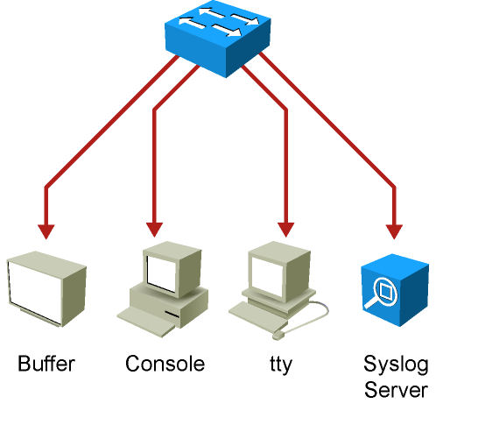
Syslog
System Message Logging
Enables device to report error and notification messages.
Uses UDP port 514.
Every message contains a severity level and a facility.
Routers, switches, application servers, firewalls, and other network appliances support syslog.
Notes:
The Cisco IOS system message logging (syslog) process enables a device to report and save important error and notification messages, either locally or to a remote logging server. Syslog messages can be sent to local console connections, the system buffer, or remote syslog servers.
Syslog enables text messages to be sent to a syslog server using UDP port 514.
Syslog provides a comprehensive reporting mechanism that logs system messages in plain English text.
The syslog messages include both messages in a standardized format (called system logging messages, system error messages, or simply system messages) and output from debug commands.
These messages are generated during network operation to assist with identifying the type and severity of a problem or to aid users in monitoring router activity such as configuration changes.
The system message and error reporting service (syslog) is an essential component of any network operating system.
The system message service reports system state information to a network manager.
Cisco devices produce syslog messages as a result of network events.
Every syslog message contains a severity level and a facility.
Many networking devices support syslog, including routers, switches, application servers, firewalls, and other network appliances.

Slide 31
Syslog Severity Levels
Smaller numerical levels are the more critical syslog alarms.
Syslog Severity | Severity Level
Emergency | Level 0, highest level
Alert | Level 1
Critical | Level 2
Error | Level 3
Warning | Level 4
Notice | Level 5
Informational | Level 6
Debugging | Level 7
Notes:
The complete list of syslog levels are shown.

Slide 32
Syslog Facilities
Service identifiers.
Identify and categorize system state data for error and event message reporting.
Cisco IOS has more than 500 facilities.
Most common syslog facilities:
IP
OSPF
SYS operating system
IP Security (IPsec)
Route Switch Processor (RSP)
Interface (IF)
Notes:
Other facilities include Cisco Discovery Protocol, STP, multicast, IPsec, TCP, BGP, RADIUS, Telnet, and those facilities related to QoS services.
More syslog information is located at www.cisco.com/univercd/cc/td/doc/product/software/ios123/123sup/123sems/index.htm

Slide 33
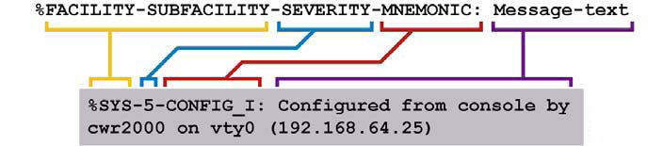
Syslog Message Format
System messages begin with a percent sign (%)
Facility: A code consisting of two or more uppercase letters that indicates the hardware device, protocol, or a module of the system software.
Severity: A single-digit code from 0 to 7 that reflects the severity of the condition. The lower the number, the more serious the situation.
Mnemonic: A code that uniquely identifies the error message.
Message-text: A text string describing the condition. This portion of the message sometimes contains detailed information about the event, including terminal port numbers, network addresses, or addresses that correspond to locations in the system memory address space.
Notes:
The figure shows a typical message that indicates the operating system (facility = SYS) is providing a notification (SEVERITY = 5) has been configured (MNEUMONIC = CONFIG).
The message text indicates that a user on VTY0 from IP address 192.168.64.25 made this change.
System log messages can contain up to 80 characters and a percent sign (%), which follows the optional sequence number or timestamp information, if configured.
Messages are displayed in this format:
seq no:timestamp: %facility-severity-MNEMONIC:description
A sequence number appears on the syslog message if the service sequence-numbers global configuration command is configured.
The timestamp shows the date and time of the message or event if the service timestamps [debug | log] [datetime uptime] [localtime |msec|show-timezone|year] global configuration command is configured.
The timestamp can be have one of three formats:
mm/dd hh:mm:ss
hh:mm:ss (short uptime)
d h (long uptime)
Note: The documentation for each Cisco IOS Software release explains the meaning of these messages.
For example, Catalyst 6500 system error message explanations are available at this location: www.cisco.com/en/US/products/hw/switches/ps708/products_system_message_guides_list.html

Slide 34
Sample Syslog Messages
08:01:13: %LINEPROTO-5-UPDOWN: Line protocol on Interface FastEthernet0/5, changed state to up
08:01:23: %DUAL-5-NBRCHANGE: EIGRP-IPv4:(1) 1: Neighbor 10.1.1.1 (Vlan1) is up: new adjacency
08:02:31: %LINK-3-UPDOWN: Interface FastEthernet0/8, changed state to up
08:18:20: %LINEPROTO-5-UPDOWN: Line protocol on Interface FastEthernet0/5, changed state to down
08:18:22: %LINEPROTO-5-UPDOWN: Line protocol on Interface FastEthernet0/5, changed state to up
08:18:24: %LINEPROTO-5-UPDOWN: Line protocol on Interface FastEthernet0/2, changed state to down
08:18:24: %ILPOWER-5-IEEE_DISCONNECT: Interface Fa0/2: PD removed
08:18:26: %LINK-3-UPDOWN: Interface FastEthernet0/2, changed state to down
08:19:49: %ILPOWER-7-DETECT: Interface Fa0/2: Power Device detected: Cisco PD
08:19:53: %LINK-3-UPDOWN: Interface FastEthernet0/2, changed state to up
08:19:53: %LINEPROTO-5-UPDOWN: Line protocol on Interface FastEthernet0/2, changed state to up
Notes:
The example shows samples of syslog messages that Cisco IOS Software produces.
The most common messages are link up and down messages and messages that a device produces when it exits from configuration mode.
If ACL logging is configured, the device generates syslog messages when packets match a parameter condition.
ACL logging can be useful for detecting packets that are denied access based on the security policy set by an ACL.

Slide 35
Configuring Syslog (1)
To configure a syslog server, use the logging ip_addr global configuration command.
To which severity levels of messages are sent to the syslog server, use the global configuration command logging trap level.
Switch(config)# logging trap ?
<0-7> Logging severity level
alerts Immediate action needed (severity=1)
critical Critical conditions (severity=2)
debugging Debugging messages (severity=7)
emergencies System is unusable (severity=0)
errors Error conditions (severity=3)
informational Informational messages (severity=6)
notifications Normal but significant conditions (severity=5)
warnings Warning conditions (severity=4)
Notes:
Messages can be sent to a syslog server.

Slide 36
Configuring Syslog (2)
To configure logging to the buffer of the local switch, use the command logging buffered.
Switch(config)# logging buffered ?
<0-7> Logging severity level
<4096-2147483647> Logging buffer size
alerts Immediate action needed (severity=1)
critical Critical conditions (severity=2)
debugging Debugging messages (severity=7)
discriminator Establish MD-Buffer association
emergencies System is unusable (severity=0)
errors Error conditions (severity=3)
informational Informational messages (severity=6)
notifications Normal but significant conditions (severity=5)
warnings Warning conditions (severity=4)
xml Enable logging in XML to XML logging buffer
Notes:
Messages can be stored on the local switch. To configure the local logs, use the command logging buffered.
Valid parameters are the maximum local log size and the severity level that has to be logged:
Enabling higher logging with small buffer size might mean that your logging displays only a short duration of time before newer messages overwrite the older ones.
Ensure the local log size is an appropriate size for your level of logging and time frame that you would like to see in the local logs.

Slide 37
Verifying Syslog Configuration
Use the show logging command to display the content of the local log files.
Use the pipe argument (|) in combination with keywords such as include or begin to filter the output.
Switch# show logging | include LINK-3
2d20h: %LINK-3-UPDOWN: Interface FastEthernet0/1, changed state to up
2d20h: %LINK-3-UPDOWN: Interface FastEthernet0/2, changed state to up
2d20h: %LINK-3-UPDOWN: Interface FastEthernet0/1, changed state to up
Switch# show logging | begin %DUAL
2d22h: %DUAL-5-NBRCHANGE: EIGRP-IPv4:(10) 10: Neighbor 10.1.253.13
(FastEthernet0/11) is down: interface down
2d22h: %LINK-3-UPDOWN: Interface FastEthernet0/11, changed state to down
2d22h: %LINEPROTO-5-UPDOWN: Line protocol on Interface FastEthernet0/11, changed state to down
Notes:
Use the show logging command to display the content of the local log files.
When too many events are present in the log files, use the pipe argument (|) in combination with keywords such as include or begin to filter the output.
The example shows how to display all events present in the local logs that involve an error report (severity level 3) about interface link status.
The second example shows how to display all events that start with %DUAL (therefore reporting events related to the EIGRP DUAL algorithm).

Slide 38
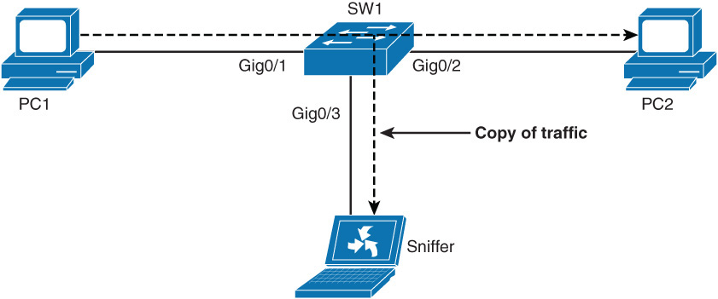
SPAN and RSPAN
The Switch Port Analyzer (SPAN) feature allows you to instruct a switch to send copies of packets seen on one port, multiple ports, or a VLAN to another port on the same switch.
To capture and analyze the traffic flowing from PC1 to PC2 on the sniffer, SPAN configuration is required.

Slide 39
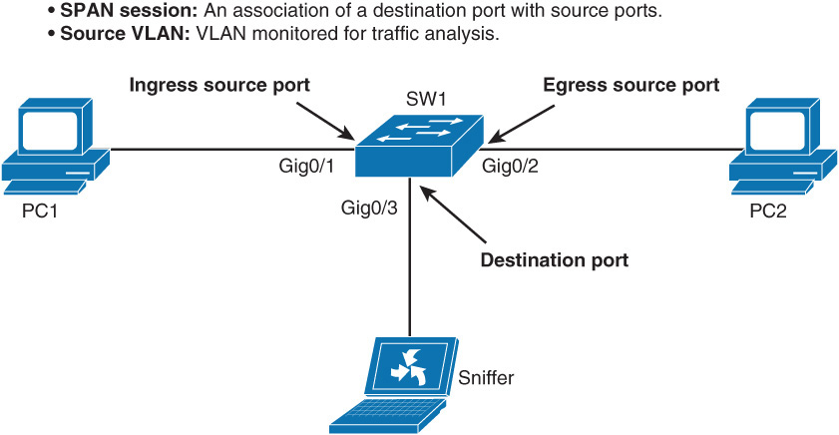
SPAN and RSPAN
SPAN also supports monitoring traffic from an entire VLAN. In a single switch, this feature may be useful.
However, in a large network, the sniffer may not have the processing power to capture traffic for all the communication on a VLAN.
SPAN features two different port types. The source port is a port that is monitored for traffic analysis. SPAN can copy ingress, egress, or ingress and egress traffic from a source.

Slide 40
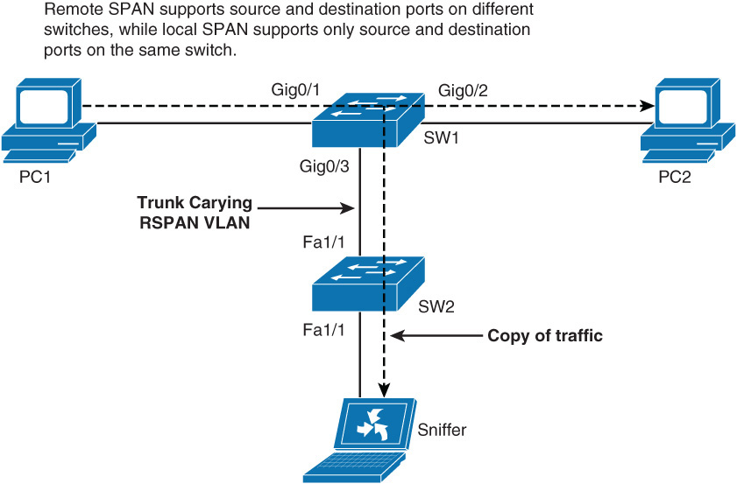
SPAN and RSPAN
Alternatively, you can specify a source VLAN, where all ports in the source VLAN become sources of SPAN traffic.
Each SPAN session can have either ports or VLANs as sources, but not both.
Remote SPAN (RSPAN) feature takes the SPAN feature beyond a single switch to a network.
In terms of configuration, RSPAN consists of the following:
RSPAN source session
RSPAN VLAN
RSPAN destination session

Slide 41
SPAN Configuration
A destination port cannot be a source port or vice versa.
The number of destination ports is platform dependent; some platforms allow for more than one destination.
Destination ports do not act as normal ports and do not participate in spanning tree and so on. Normal traffic flows through a destination. Be careful not to connect anything besides an end device to a SPAN destination port.
The SPAN session is identified by a session number
Step 1: Associate SPAN session with source ports or VLANs by using the following command: monitor session number source interface/vlans
Step 2: Associate destination port with SPAN session number by using the following command: monitor session number destination interface/vlans

Slide 42
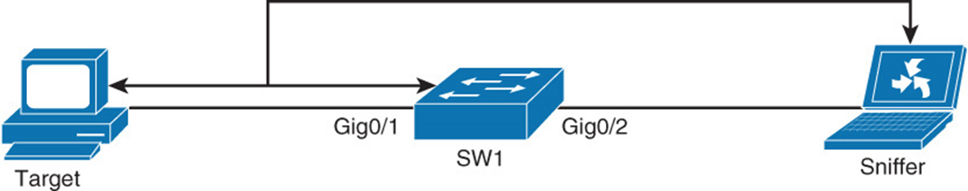
SPAN Configuration Example
Switch1(config)# monitor session 1 source interface GigabitEthernet 0/1 Switch1(config)# monitor session 1 destination interface GigabitEthernet 0/2 Switch1# show monitor Session 1 --------- Type : Local Session Source Ports : Both : Gi0/1 Destination Ports : Gi0/2 Encapsulation : Native Ingress : Disabled

Slide 43
Remote SPAN (RSPAN)
Cisco’s RSPAN feature is a revolutionary feature that allows creating SPAN sessions that cross physical switch boundaries.
With RSPAN, because the source and destination ports are on different switches, a special and unique VLAN is required to transport the traffic from one switch to another.
You configure this VLAN as any other VLAN, but in addition, you enter the remote-span keyword in VLAN configuration mode.
You need to define this VLAN on all switches in the path and allow the VLAN on trunk ports between the source and destination.
Remote SPAN uses two sessions, one session as the source and one session to copy or receive the traffic from a VLAN.

Slide 44
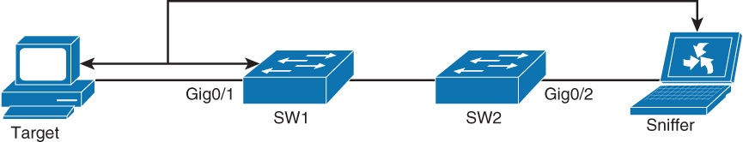
Remote SPAN (RSPAN) Example
RSPAN needs to be set up for the sniffer attached to SW2 and needs to be configured to view the traffic to and from the PC attached to SW1.
SW1(config)# vlan 100 SW1(config-vlan)# name RSPAN-VLAN SW1(config-vlan)# remote-span SW1(config-vlan)# exit SW1(config)# monitor session 2 source interface GigabitEthernet0/1 SW1(config)# monitor session 2 destination remote vlan 100
SW2(config)# vlan 100 SW2(config-vlan)# name RSPAN-VLAN SW2(config-vlan)# remote-span SW2(config-vlan)# exit SW2(config)# monitor session 2 destination interface GigabitEthernet 0/2 SW2(config)# monitor session 2 source remote vlan 100

Slide 45
Verifying RSPAN
When verifying the configuration, the output of the show monitor
SW1# show monitor Session 2 --------- Type : Remote Source Session Source Ports : Both : Gi0/2 Dest RSPAN VLAN : 100 SW2# show monitor --------- Type : Remote Destination Session Source RSPAN VLAN : 100 Destination Ports : Gi0/2 Encapsulation : Native Ingress : Disabled
It is also important that you verify that the VLAN is configured correctly as RSPAN VLAN on both switches. You can verify this by using the show vlan remote-span command.

Slide 46
IP SLA
Notes:
Network security vulnerabilities include loss of privacy, data theft, impersonation, and loss of integrity. Basic security measures should be taken on every network to mitigate adverse effects of user negligence or acts of malicious intent. Best practices following these general steps are required whenever placing new equipment in service.
Step 1. Consider or establish organizational security policies.
Step 2. Secure switch device and protocols.
Step 3. Mitigate compromises launched through a switch.

Slide 47
Introduction to IP Service Level Agreement
An SLA (service level agreement) is a contract between the network provider and its customers, or between a network department and internal corporate customers. It provides a form of guarantee to customers about the level of user experience.
SLA may contain specifics about connectivity and performance agreements for an enduser service from a service provider.
An SLA typically outlines the minimum level of service and the expected level of service.
Notes:
The network has become increasingly critical for customers, and any downtime or degradation can adversely impact revenue.
Companies need some form of predictability with IP services.
An SLA is a contract between the network provider and its customers, or between a network department and internal corporate customers.
It provides a form of guarantee to customers about the level of user experience.
An SLA specifies connectivity and performance agreements for an end-user service from a service provider.
The SLA typically outlines the minimum level of service and the expected level of service.
The networking department can use the SLAs to verify that the service provider is meeting its own SLAs or to define service levels for critical business applications.
An SLA can also be used as the basis for planning budgets and justifying network expenditures.
Administrators can ultimately reduce the mean time to repair (MTTR) by proactively isolating network issues.
They can change the network configuration based on optimized performance metrics.
Typically, the technical components of an SLA contain a guarantee level for network availability, network performance in terms of round-trip time (RTT), and network response in terms of latency, jitter, and packet loss.
The specifics of an SLA vary depending on the applications an organization is supporting in the network.

Slide 48
Introduction to IP Service Level Agreement
An SLA can also be used as the basis for planning budgets and justifying network expenditures.
Overall, the IP SLA feature provides real-time feedback about network reachability. For features such as voice and video, network availability with stable jitter and latency are important.
The IP SLA provides the feedback necessary to ensure the network can sustain real-time applications as well as mission-critical applications such as web portal or ordering.
Notes:
The network has become increasingly critical for customers, and any downtime or degradation can adversely impact revenue.
Companies need some form of predictability with IP services.
An SLA is a contract between the network provider and its customers, or between a network department and internal corporate customers.
It provides a form of guarantee to customers about the level of user experience.
An SLA specifies connectivity and performance agreements for an end-user service from a service provider.
The SLA typically outlines the minimum level of service and the expected level of service.
The networking department can use the SLAs to verify that the service provider is meeting its own SLAs or to define service levels for critical business applications.
An SLA can also be used as the basis for planning budgets and justifying network expenditures.
Administrators can ultimately reduce the mean time to repair (MTTR) by proactively isolating network issues.
They can change the network configuration based on optimized performance metrics.
Typically, the technical components of an SLA contain a guarantee level for network availability, network performance in terms of round-trip time (RTT), and network response in terms of latency, jitter, and packet loss.
The specifics of an SLA vary depending on the applications an organization is supporting in the network.

Slide 49
Additional functions and Uses for IP SLA
Edge-to-edge network availability monitoring
Network performance monitoring and network performance visibility
VoIP, video, and virtual private network (VPN) monitoring
IP service network health readiness or assessment
Multiprotocol Label Switching (MPLS) network monitoring
Troubleshooting of network operation

Slide 50
IP SLA Feedback
From a network perspective, IP SLA provides feedback on these functions (among others):
Gather information of VoIP quality.
Track interfaces to influence behavior of first-hop redundancy protocols (Hot Standby Router Protocol [HSRP], Virtual Router Redundancy Protocol [VRRP], Gateway Load Balancing Protocol [GLBP]).
When thresholds are breached, schedule further IP SLA tests that will tell you more about your network.
When a threshold is breached send an SNMP trap.

Slide 51
Types of measurement statistics
IP SLA measures various operation characters via actively generated traffic probes. These probes gather statistics such as the following:
Network latency and response time
Packet-loss statistics
Network jitter and voice quality scoring
End-to-end network connectivity
Multiple IP SLA operations (measurements) can be running in a network at any given time. Reporting tools then can use SNMP to extract the data into a database and then report on it.

Slide 52
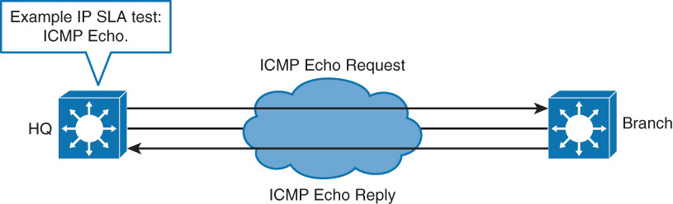
Simple example of an IP SLA Test
A simple example of an IP SLA test is the ICMP echo test. IP SLA uses ICMP Echo Request and Response packets to test availability of far-end devices.
The far-end device can be any device with IP capabilities such as router, switch, PC, or server.
Overall, the IP SLA feature provides real-time feedback about network reachability.
For features such as voice and video, network availability with stable jitter and latency are important.

Slide 53
IP SLA Source and Responder
IP SLA source is where all IP SLA measurement probe operations are configured either by CLI or through an SNMP tool that supports IP SLA operation.
Source is also the Cisco IOS device that sends probe packets.
Destination of probe might be another Cisco router or another network target, such as a web server or IP host.
Although destination of probe can be any IP device, measurement accuracy is improved with IP SLA responder.
IP SLA responder is device running Cisco IOS and is configured as IP SLA measurement responder with the ip sla responder configuration command.
The responder adds a time stamp to the packets sent so the IP SLA source can take into account any latency that occurred while the responder is processing the test packets.
For this test to work properly, both the source and responder clocks need to be synchronized through Network Time Protocol (NTP).

Slide 54
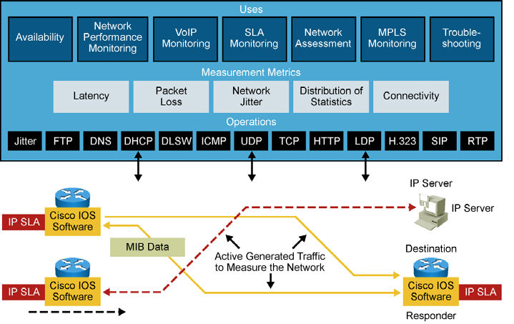
IP SLA Measurements
In Cisco IOS, IP SLA measurement enables configuration of router to send synthetic traffic to host or router configured to respond.
One-way travel times and packet loss are gathered.
Notes:
Certain measurements also enable jitter data to be collected.
Following are several common functions for IP SLA measurements:
Edge-to-edge network availability monitoring
Network performance monitoring and network performance visibility
VoIP, video, and virtual private network (VPN) monitoring
IP service network health readiness or assessment
Multiprotocol Label Switching (MPLS) network monitoring
Troubleshooting of network operation
IP SLA measurement uses a variety of operations and actively generated traffic probes to gather many types of measurement statistics:
Network latency and response time
Packet loss statistics
Network jitter and voice quality scoring
End-to-end network connectivity
Multiple IP SLA operations (measurements) can run in a network at one time. Reporting tools use SNMP to extract the data into a database and then report on it.
IP SLA measurements enable the network manager to verify service guarantees, which increases network reliability by validating network performance, proactively identifying network issues, and easing the deployment of new IP services.

Slide 55
IP SLA Configuration
To implement IP SLA network performance measurement, you need to perform the following tasks:
Step 1. Enable the IP SLAs responder, if required.
Step 2. Configure the required IP SLA’s operation type.
Step 3. Configure any options available for the specified operation type.
Step 4. Configure threshold conditions, if required.
Step 5. Schedule the operation to run, and then let the operation run for a period of time to gather statistics.
Step 6. Display and interpret the results of the operation using the Cisco IOS CLI or a network management system (NMS) with SNMP.
Switch(config)# ip sla 12 Switch(config-ip-sla)# icmp-echo 192.168.139.134 Switch(config-ip-sla-echo)# frequency 30 Switch(config-ip-sla-echo)# exit Switch(config)# ip sla schedule 5 start-time now life forever Switch(config)# end

Slide 56
Verify the configuration of IP SLA
To verify the configuration of IP SLA, leverage the show ip sla configuration operation-number command.
Switch# show ip sla configuration 22 IP SLAs, Infrastructure Engine-II. Entry number: 12 Owner: Tag: Type of operation to perform: echo Target address: 192.168.139.134 Source address: 0.0.0.0 Request size (ARR data portion): 28 Operation timeout (milliseconds): 5000 Type Of Service parameters: 0x0 Verify data: No Vrf Name: Schedule: Operation frequency (seconds): 30 Next Scheduled Start Time: Pending trigger Group Scheduled : FALSE Randomly Scheduled : FALSE Life (seconds): 3600 Entry Ageout (seconds): never Recurring (Starting Everyday): FALSE Status of entry (SNMP RowStatus): notInService Threshold (milliseconds): 5000 Distribution Statistics: Number of statistic hours kept: 2 Number of statistic distribution buckets kept: 1 Statistic distribution interval (milliseconds): 20 History Statistics: Number of history Lives kept: 0 Number of history Buckets kept: 15 History Filter Type: None Enhanced History:

Slide 57
Verifying IP SLA Configuration
When IP SLA is configured, the test is conducted as per the scheduled configuration. The test might succeed or fail. If you do not monitor the test results, it might fail silently.
To display information about the test, use the show ip sla statistics command.
Switch# show ip sla statistics
Round Trip Time (RTT) for Index 1
Latest RTT: NoConnection/Busy/Timeout
Latest operation start time: 11:11:22.533 eastern Thu Jul 9 2010
Latest operation return code: Timeout
Over thresholds occurred: FALSE
Number of successes: 177
Number of failures: 6
Operation time to live: Forever
Operational state of entry: Active
Last time this entry was reset: Never
Notes:
The show ip sla statistics command displays, among other parameters, the number of successes and number of failures.
It also shows if the test is still being run.
Here we see that the test in active state, having succeeded 177 times and failed 6 times when the command was issued.
Monitoring these statistics over time can tell you if there is a connection issue discovered through the IP SLA test.

Slide 58
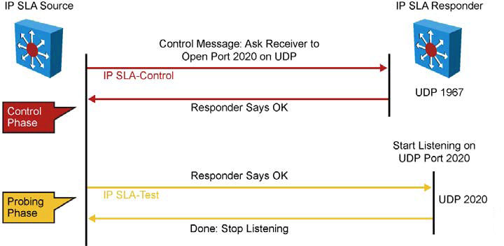
IP SLA Operation with Responder
Network manager configures IP SLA operation by defining a target device, protocol, and port number on IP SLA source. Network manager can also configure reaction conditions. Operation is scheduled to be run for a period of time to gather statistics.
Notes:
The figure shows the sequence of events that occurs for each IP SLA operation that requires a responder on the target:
At the start of the control phase, the IP SLA source sends a control message with the configured IP SLA operation information to IP SLA control port UDP 1967 on the target router.
The control message carries information such as protocol, port number, and duration:
If MD5 authentication is enabled, MD5 checksum is sent with the control message.
If the authentication of the message is enabled, the responder verifies it; if the authentication fails, the responder returns an authentication failure message.
If the IP SLA measurement operation does not receive a response from a responder, it tries to retransmit the control message and eventually times out.
If the responder processes the control message, it sends an OK message to the source router and listens on the port specified in the control message for a specified duration.
If the responder cannot process the control message, it returns an error. In the figure, UDP port 2020 will be used for the IP SLA test packets.
If the return code of control message is OK, the IP SLA operation moves to the probing phase, where it sends one or more test packets to the responder for response time computations.
The return code is available in the show ip sla statistics command. In the figure, these test messages are sent on control port 2020.
The responder accepts the test packets and responds.
Based on the type of operation, the responder might add an “in” timestamp and an “out” timestamp in the response packet payload to account for CPU time spent in measuring unidirectional packet loss, latency, and jitter to a Cisco device.
These timestamps help the IP SLA source to make accurate assessments on one-way delay and the processing time in the target routers.
The responder disables the user-specified port when it responds to the IP SLA measurements packet or when a specified time expires.

Slide 59
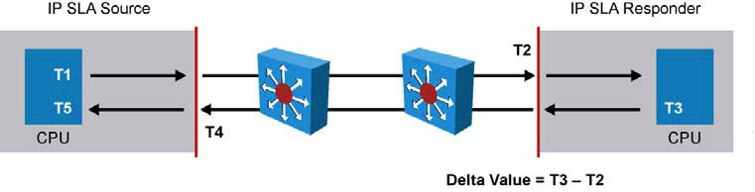
IP SLA Responder Timestamps
IP SLA responder timestamps are used in round-trip calculations.
IP SLA source sends test packet at time T1.
IP SLA responder includes receipt time (T2) and transmitted time (T3).
Notes:
The figure illustrates the use of IP SLA responder timestamps in round-trip calculations.
The IP SLA source uses four timestamps for the round-trip time (RTT) calculation. The IP SLA source sends a test packet at time T1.
The IP SLA responder includes both the receipt time (T2) and the transmitted time (T3).
Because of other high-priority processes, routers can take tens of milliseconds to process incoming packets.
The delay affects the response times because the reply to test packets might be sitting in a queue while waiting to be processed.
This timestamping is made with a granularity of submilliseconds.
At times of high network activity, an ICMP ping test often shows a long and inaccurate response time, whereas an IP SLA–based responder shows an accurate response time.
The IP SLA source subtracts T2 from T3 to produce the time spent processing the test packet in the IP SLA responder.
This time is represented by a delta value.
The delta value is then subtracted from the overall RTT.
The same principle is applied by the IP SLA source where the incoming T4 is also taken at the interrupt level to allow for greater accuracy as compared to T5 when the packet is processed.
An additional benefit of two timestamps at the IP SLA responder is the ability to track one-way delay, jitter, and directional packet loss.
These statistics are critical because a great deal of network behavior is asynchronous. To capture one-way delay measurements, the configuration of both the IP SLA source and IP SLA responder with Network Time Protocol (NTP) is required.
Both the source and target need to be synchronized to the same clock source.
The IP SLA responder provides enhanced accuracy for measurements, without the need for dedicated third-party external probe devices.
It also provides additional statistics, which are not otherwise available via standard ICMP-based measurements.

Slide 60
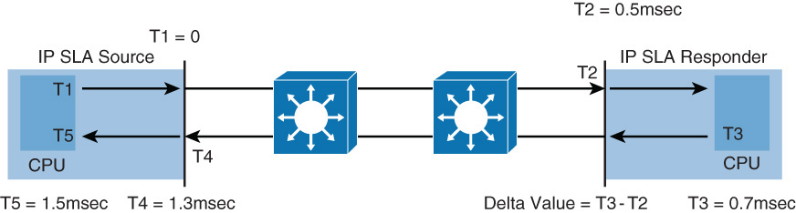
IP SLA Responder Timestamps Example
Time is marked from 0 in milliseconds for simplicity. The RTT in this example is calculated as RTT = T5 – (T5-T4) - (T3-T2)
= 1.5msec – (1.5msec-1.3msec) – (0.7msec -0.5msec) = 1.1msec.

Slide 61
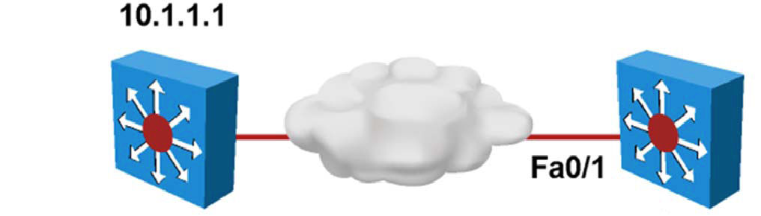
Configuring IP SLA Example
The IP SLA test is done by sending an icmp-echo message to the IP address 10.1.1.1 from the local interface Fa0/1 every 10 seconds.
SwitchB(config)# ip sla 11
SwitchB(config-sla)# icmp-echo 10.1.1.1 source-int fa0/1
SwitchB(config-sla)# frequency 10
SwitchB(config-sla)# exit
SwitchB(config)# ip sla schedule 11 life forever start-time now
SwitchB(config)# track 1 ip sla 11 reachability
Notes:
The 10.1.1.1 device should be configured to answer this message with the ip sla responder command.
At this point, the type of message is configured, along with its frequency and target address.
The next step is to decide when this test should start.
This is configured with the ip sla monitor schedule command.
The test is to start immediately and to last forever.
When the IP SLA test has been defined, additional configuration is needed to determine what action should be taken when the test result is received.
The track command follows the IP SLA test result.
Further commands can then be configured to use the track result to decrement interfaces’ priority or activate backup links.

Slide 62
IP SLA UDP Jitter example
The IP SLAs UDP jitter operation was primarily designed to diagnose network suitability for real-time traffic applications such as VoIP, video over IP, or real-time conferencing.

Slide 63
Configuring Authentication for IP SLA
One brief configuration point is that key chains are supported with IP SLAs to ensure authentication of control messages.
Key chains must be configured on both IP SLA source and responder as a first step.
Switch(config)# key chain MYKEY Switch(config-keychain)# key 1 Switch(config-keychain-key)# key-string SuperSecretPWD Switch(config)# ip sla key-chain MYKEY

Slide 64


